Slide 1
PianoRepair &Tuning
For Physicists & Engineers using your
Laptop, Microphone, and Hammer
by
Bruce Vogelaar, Hans Robinson, Tatsu Takeuchi Virginia Tech
at
3:00 - 4:30 pm Hahn Hall North Rm 130
April 20, 2019
24 tone fun
Janko Keyboard
Fluid piano

Slide 2
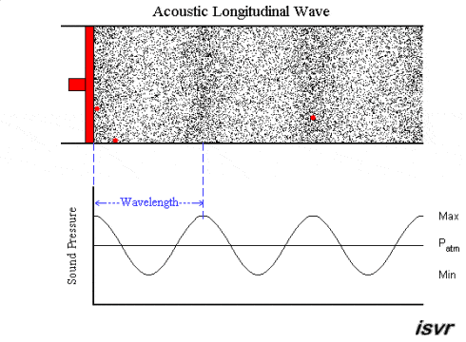
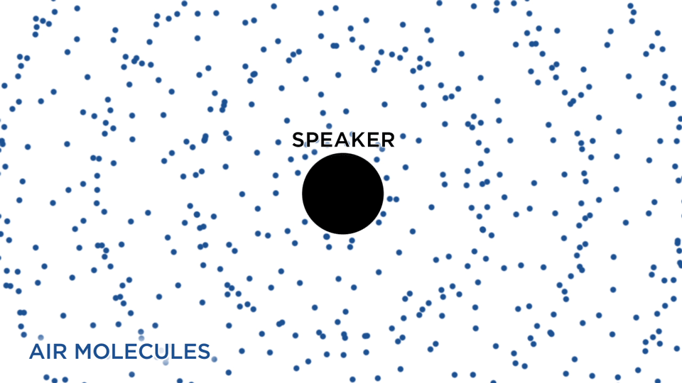
A pure sound pitch is a pressure wave travelling in air at speed $v,$ with frequency $f$, and wavelength $λ$.
note: any given gas molecule just goes back and forth.
$$fλ=v$$

Slide 3
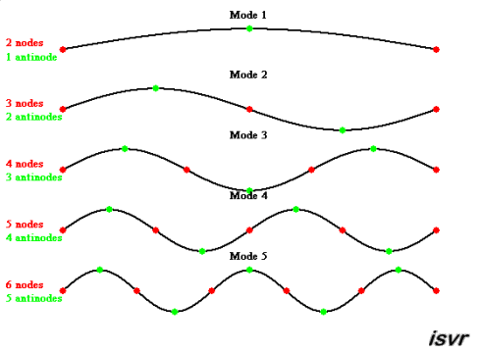
String instruments vibrate at specific frequencies:
A piano string is fixed at its two ends, and can vibrate in several harmonic modes.
$$L$$
$$L=n\frac{λ}{2};$$
$$f_{n}=\frac{v}{λ}=n\frac{v}{2L}=nf_{0}$$
$$ω_{n}=2πf_{n}$$
$$λ$$
[v = speed of wave on string]

Slide 4
Converting string motion into sound is difficult:
sound board
resonant cavity
electric pickups to amp to speaker

Slide 5
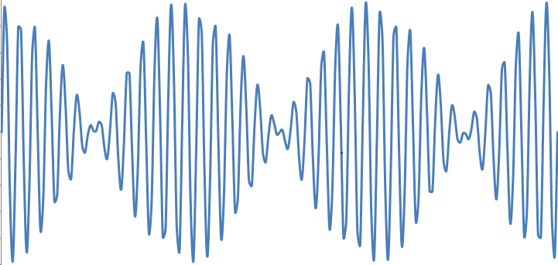
Add sounds together:
Destructive Constructive
time domain
frequency spectrum
ok harsh

Slide 6
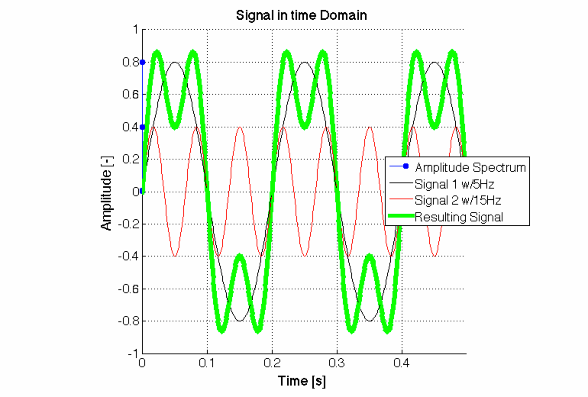
Add sounds together:
frequency content determines ‘timbre’
Invert: given the ‘sum’,
what were the components?
Fast Fourier Analysis as in FFTuner @
www.phys.vt.edu/~vogelaar
please read the Help file which covers everything here in more detail
https://www1.phys.vt.edu/~kimballton/home/pub/piano/tuner-app/FFTuning.htm

Slide 7
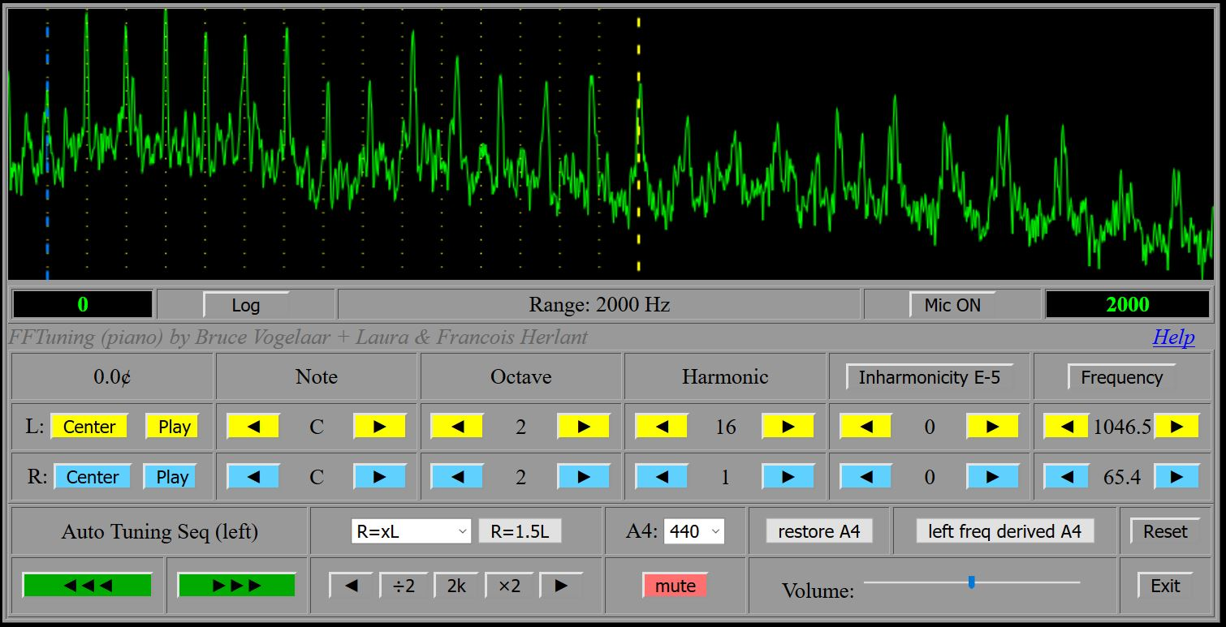
C2 struck with key; log scale makes everything easier to see
You might want a powered base microphone for the low frequencies.

Slide 8
Why some notes sound ‘harmonious’ together
or rather, which notes don’t sound terrible together…. their harmonics are either matched or well separated
(In practice, you can hardly ever avoid harmonics of a fundamental.)
pure with harmonics
$$f_{2}=1.5 f_{1}$$
A
frequency
harmonic
E
frequency
harmonic
pure with harmonics
$$f_{2}=1.55 f_{1}$$
A
E+

Slide 9
Origins of the Just Temperament
frequency note 1
frequency note 2
Octave (2/1)
5th (3/2)
4th (4/3)
Octaves are universally pleasing; to the Western ear, the 5th is next most important.
3rd (5/4)

Slide 10
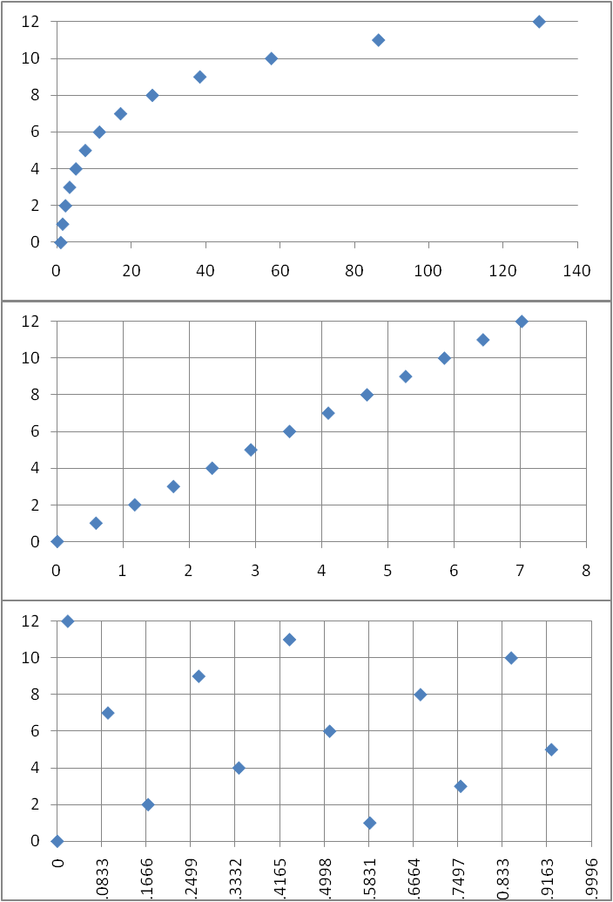
“Circle of 5th s”
Going up by 5ths
12 times brings you very
near the same note
(but 7 octaves up)
this suggests 12 notes per octave
Equal temper: space by $\sqrt[12]{2}$
‘cents’ between two notes: 1200 * log₂(f₂/f₁)
Octave = 1200 cents
(“Wolf “ fifth is off by 23 cents.)
f
Up by 5ths: (3/2)^{n}
$$1.5^{12}$$
$$2^{7}$$
log₂(f)
“Wolf ” fifth
log₂(f) shifted down into same octave

Slide 11
nearest just fraction:

Slide 12
Guitar
A guitar string is fixed at its two ends, and can vibrate in several harmonic modes.
$$L$$
$$L=n\frac{λ}{2};$$
$$f_{n}=\frac{v}{λ}=n\frac{v}{2L}=nf_{0}$$
$$ω_{n}=2πf_{n}$$
$$λ$$
[v = speed of wave on string]

Slide 13
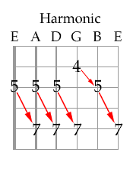
Guitar
Spacing between frets:
$\frac{f_{n+1}}{f_{n}}=\frac{L_{n}}{L_{n}−x}=\sqrt[12]{2}$
$x=\left(1−2^{−1/12 }\right)L_{n}=0.05613L_{n}$
Pressing a string between frets raises the tension in the string leading to the idea of harmonic tuning:
Play harmonics by lightly touching strings when strumming at 1/2, 1/3, 1/4 length, etc.

Slide 14
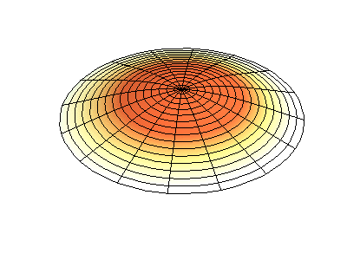
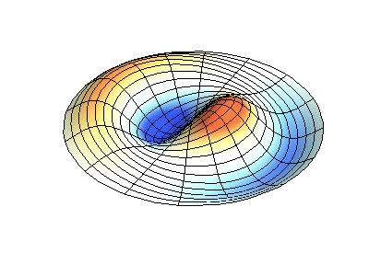
Drums
(1,2)
(0,1)
radial and azimuthal nodes

Slide 15
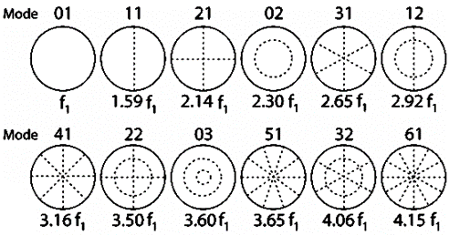
Drums
Modes of an ideal drumhead in a vacuum.
This is NOT what you’ll see on a real drum.

Slide 16
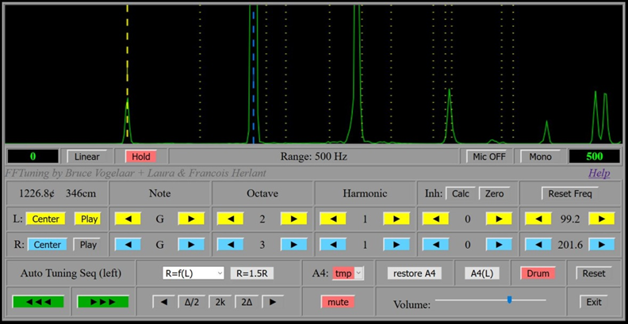
Drums
First three are (0,1), (1,1), and (2,1).
Can confirm this by dampening out other modes (like playing harmonics on a guitar)

Slide 17
Back to pianos: what an ‘aural’ piano tuner does…
for equal temperament:
tune so that desired harmonics are at the same frequency;
then, set them the required amount off by counting ‘beats’.
Octave (2/1)
5th (3/2)
4th (4/3)
3rd (5/4)

Slide 18
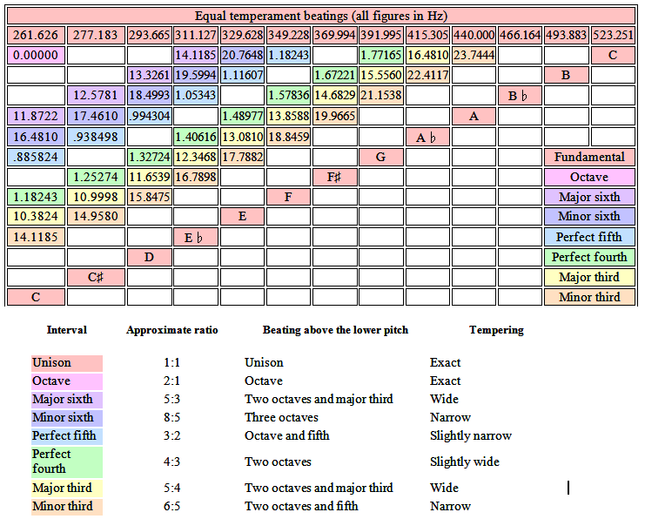
Perfect Fifth: from C, set G above it such that an octave and a fifth above the C you hear a 0.89 Hz ‘beating’
I was hopeless,
and even wrote a
synthesizer to try
and train myself…
but I still couldn’t ‘hear’ it…
These beat frequencies are for the central octave.

Slide 19
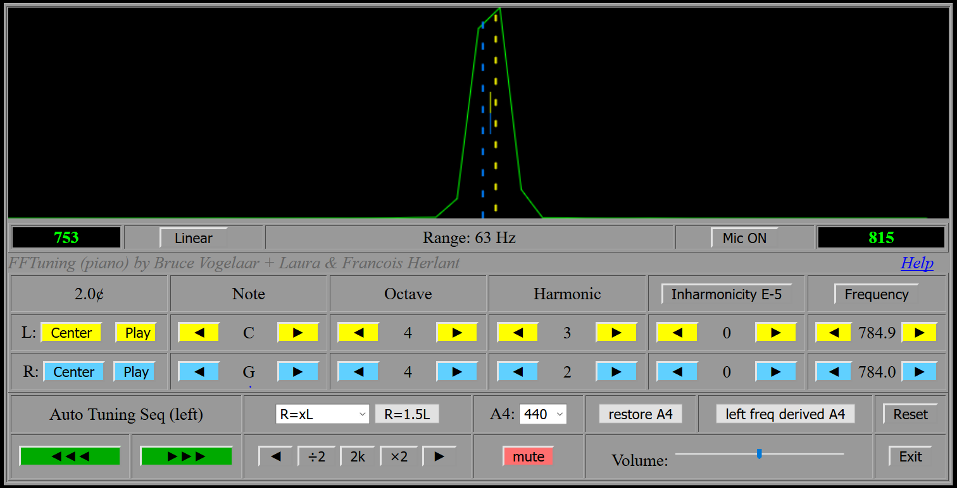
Perfect Fifth: the 2 cent beat frequency is easy to hear, when isolated.

Slide 20
Is it hopeless? not with a little help from math and a laptop… we (non-musicians) can use a spectrum analyzer…

Slide 21
With a (free) “Fourier” spectrum analyzer we can set the pitches exactly!
True Equal Temperament Frequencies
 | 0 | 1 | 2 | 3 | 4 | 5 | 6 | 7 | 8
C |  | 32.70 | 65.41 | 130.81 | 261.63 | 523.25 | 1046.50 | 2093.00 | 4186.01
C# |  | 34.65 | 69.30 | 138.59 | 277.18 | 554.37 | 1108.73 | 2217.46
D |  | 36.71 | 73.42 | 146.83 | 293.66 | 587.33 | 1174.66 | 2349.32
D# |  | 38.89 | 77.78 | 155.56 | 311.13 | 622.25 | 1244.51 | 2489.02
E |  | 41.20 | 82.41 | 164.81 | 329.63 | 659.26 | 1318.51 | 2637.02
F |  | 43.65 | 87.31 | 174.61 | 349.23 | 698.46 | 1396.91 | 2793.83
F# |  | 46.25 | 92.50 | 185.00 | 369.99 | 739.99 | 1479.98 | 2959.96
G |  | 49.00 | 98.00 | 196.00 | 392.00 | 783.99 | 1567.98 | 3135.96
G# |  | 51.91 | 103.83 | 207.65 | 415.30 | 830.61 | 1661.22 | 3322.44
A | 27.50 | 55.00 | 110.00 | 220.00 | 440.00 | 880.00 | 1760.00 | 3520.00
A# | 29.14 | 58.27 | 116.54 | 233.08 | 466.16 | 932.33 | 1864.66 | 3729.31
B | 30.87 | 61.74 | 123.47 | 246.94 | 493.88 | 987.77 | 1975.53 | 3951.07

Slide 22
But first – a critical note about ‘real’ strings (where ‘art’ can’t be avoided)
strings have ‘stiffness’
bass strings are wound to reduce this, but not all the way to their ends
treble strings are very short and ‘stiff’
thus harmonics are not true multiples of fundamentals
f_{n} is increased by a factor of $\sqrt{1+βn2 }$

Slide 23
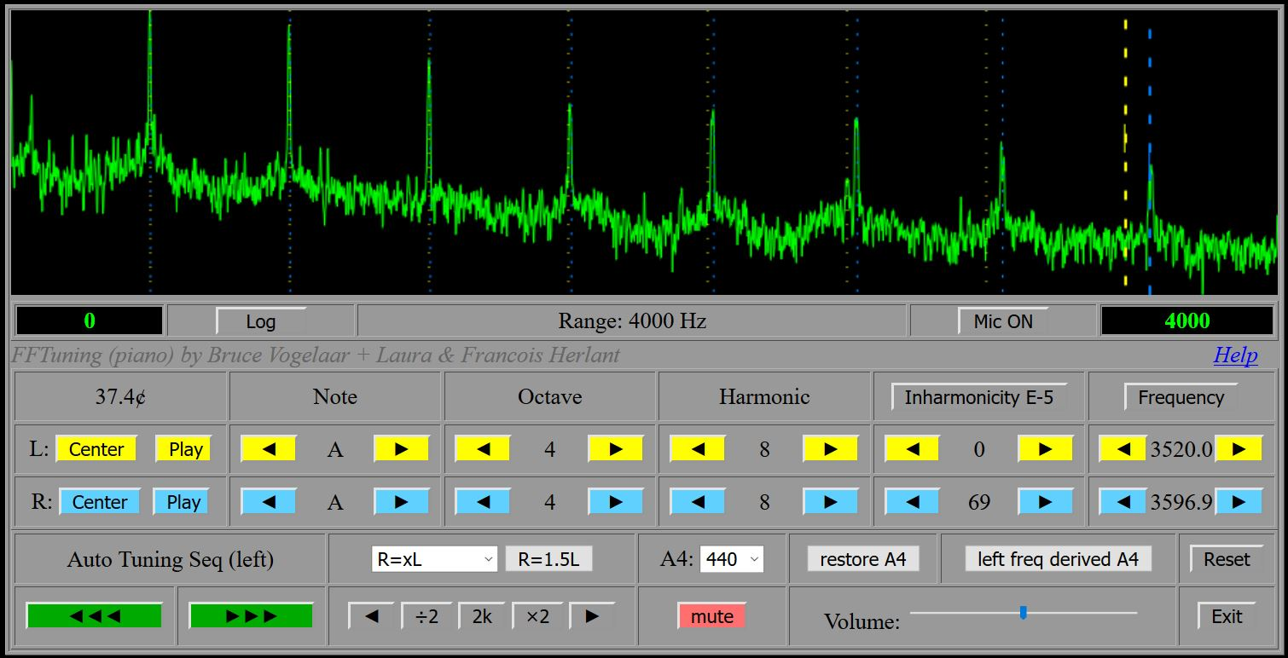
A4 (440) inharmonicity
which should match A7?
true 8x440 piano

Slide 24
Tuning the ‘A’ keys: Ideal strings
$$f_{0}=440(2^{n});n=−4⋯2$$
All the harmonics
On a log scale
Only the nearby octaves

Slide 25
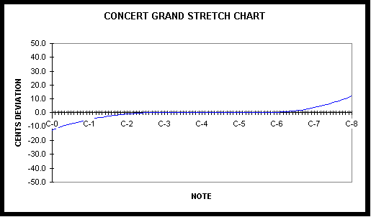
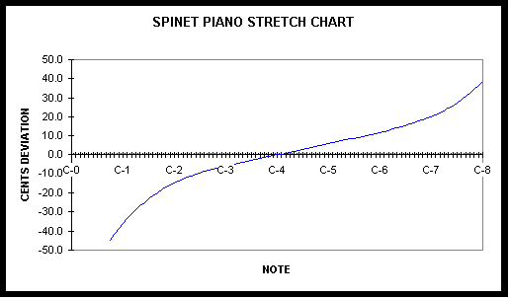
With 0.001 inharmonicity
sounds ‘sharp’
sounds ‘flat’
How many cents from perfect.
Need to “Stretch” the tuning. Can not match all harmonics, must compromise → ‘art’

Slide 26
the FFTuner approach
Pluck/strike one string at a time
Tune octaves 3, 4, and 5 to their exact frequencies (setting the ‘temper’ and eliminating ‘stretch’ for this region as a reasonable first estimate).
For octaves 0, 1, and 2, tune their 8th, 4th, and 2nd harmonics respectively to match the same note in octave 3.
For octaves 6 and 7, tune their fundamentals to match the 2nd and 4th harmonics respectively from octave 5.
FFTuner pre-populates these choices to expedite the process. See Help file for lots of explanation.

Slide 27
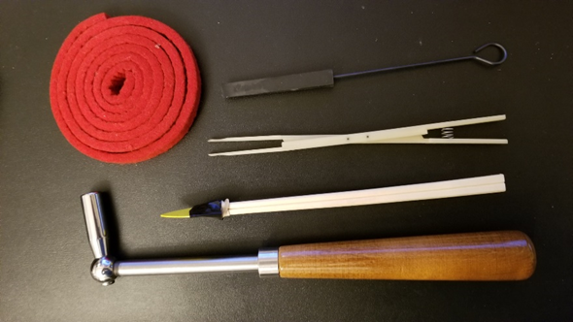
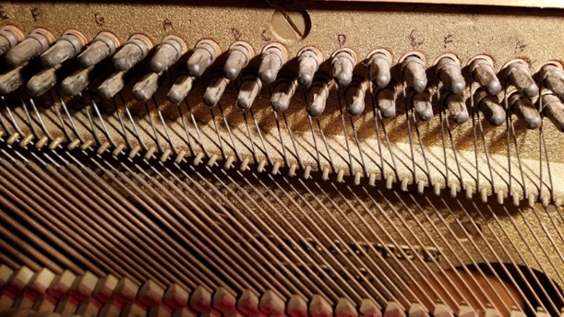
tools of the trade…

Slide 28
! but some keys don’t work !
pianos were designed to be repairable
- likely need to remove ‘action’
(if you break a string tuning it, you’ll need to remove the ‘action’ anyway)
(remember to number the keys before removing them and mark which keys hit which strings)
“Regulation” Fixing keys, and making mechanical adjustments so they work optimally, and ‘feel’ uniform.

Slide 29
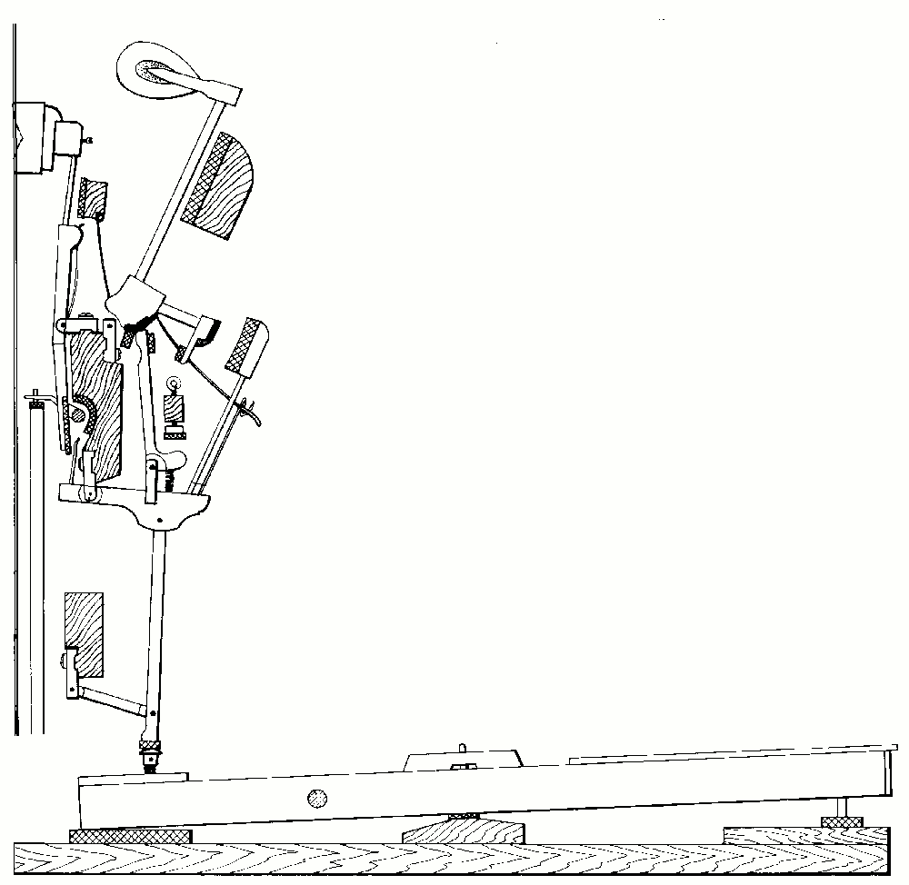
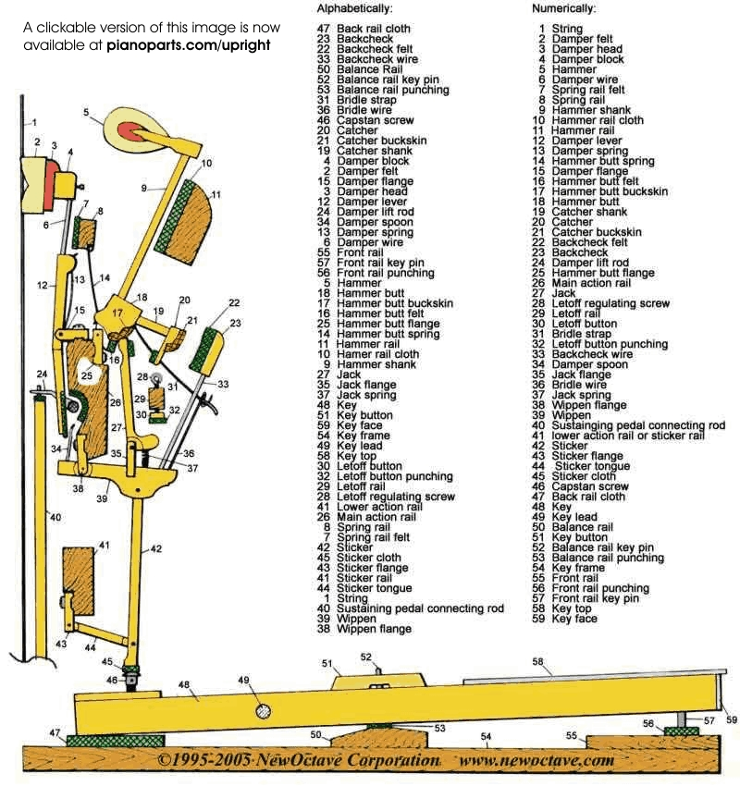
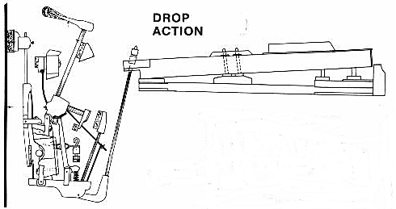
a pain on spinets

Slide 30
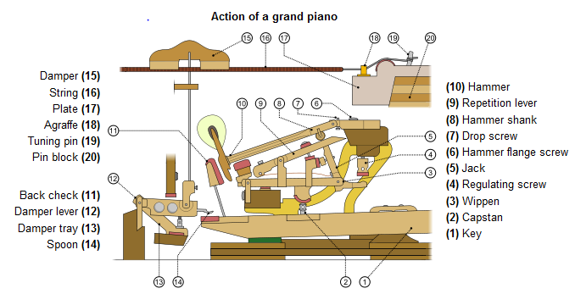
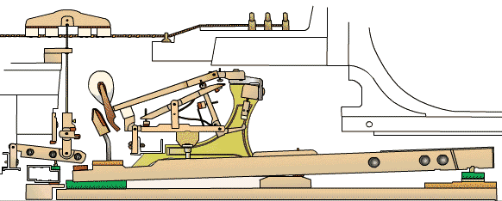

Slide 31
“Voicing” the hammers
NOT for the novice (you can easily ruin a set of hammers)

Slide 32
Let’s now do it for real…
pin turning
unisons (‘true’ or not?)
tune using FFTuner
put it back together

Slide 33
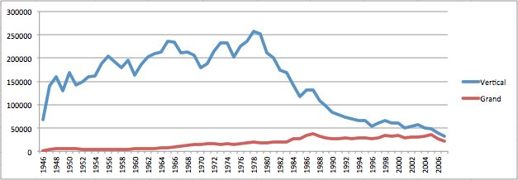
US Annual Piano Sales
getting harder to find…

